Slide 1

Motorcycle sales Performance.
Contents:
1). Introduction
2). Project Overview
3). Data Description
4). Dashboard design and KPI
5). Sales Analysis
6) Key Insights and findings

Slide 2

Introduction
Name: Darshana Shahaji Pawar
Topic: Bike sales Performance Overview
Objectives of the project: The project focuses on the revenue analysis as per to various aspects like cities, unit sold, revenue etc. Regression analysis is used to predict the model is significant or no. There was no user input so I just found the insights and the forecast about revenue.
Tools used: Python, SQL, power BI
Python- Cleaning data
SQL- To perform some highest and lowest values
Power BI- Visualization and modelling.

Slide 3

Project Overview.
My project focuses mainly on last two years of bike sales. It showcase the difference between the two years. I have also analyse that the profit has increases from past year. If we focuses on few aspect the profit will be increase more.
The default profit is ₹ 1,29,584, even if there is 0 unit sold the profit will be the same. I also want to showcase the revenue increasing by per unit. If we sell 1 unit the profit increases by ₹1,04,668.
We are 95% confidence that each unit sold increases the revenue between ₹8K to ₹13K.

Slide 4

Data description.
The dataset contains bike sales for last two years 2024 and 2025. It also includes revenue, unit sold, customer feedback, bike model and time period.
Data was absolutely clean, there was no duplicate values no null values.
We derived insights like total revenue as per to city, as per to the unit sold. This model is significant as the p value <0.05.
The columns that we have is unit sold, time period, model name this impact 46% on a profit and rest 54% depends upon other aspects like discount, price, etc.
Correlation is 1 so it is stronger relationship.

Slide 5
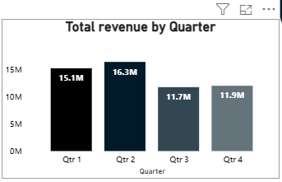
Dashboard design and KPI
Total Revenue by Quarter.
*As we can see here, this chart shows total revenue earned by quarter. Minimum revenue is in 3rd quarter and the maximum quarter is in 2nd quarter.
There is a drop in revenue after 3rd quarter, but we can also see slight increase after quarter 3.

Slide 6
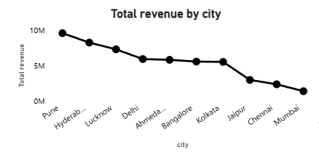
Total Revenue by city.
This line chart shows total revenue earned as per to the city
The highest revenue is earned by Pune city whereas the lower is in Mumbai.

Slide 7
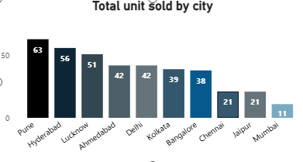
Total Units sold by city.
Here we can see that highest unit sold is 63 bikes in Pune city. In previous slid we checked that the highest revenue was in Pune city that means unit sold has a great impact on revenue.
The lowest unit sold is in Mumbai which leads to lowest revenue in that City as well.

Slide 8
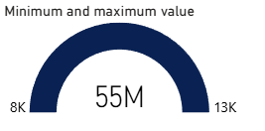
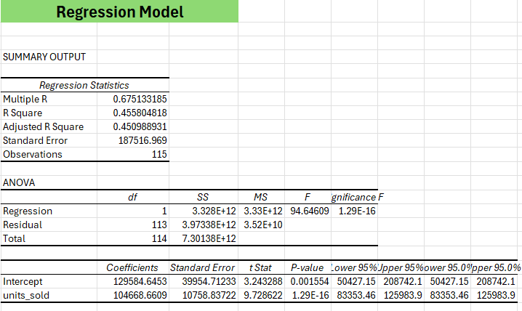
Maximum and Minimum value.
Here we can see that we are 95% accurate about the minimum and maximum value.
If we check the F value it says that it is 95% accurate and significant.
In this chart we can see that by selling even 1 unit we can earn revenue between 8k to 13K.
The p value<0.05 that means our model is highly significant.

Slide 9
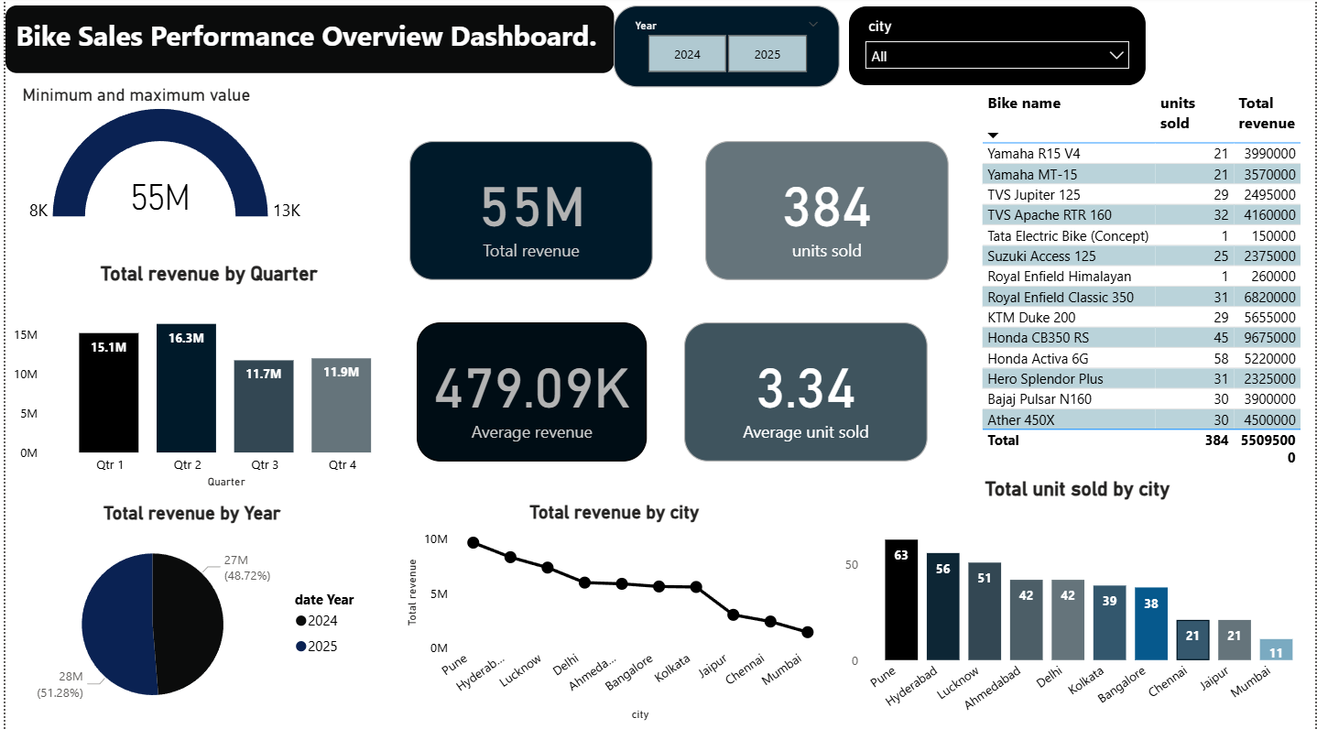

Slide 10
Conclusion.
This dashboard summarizes overall bike sales performance across quarters, Cities, and models. Total revenue stands at 55M, with Q2 being the highest performing quarter. Pune emerges as the top revenue- generating city, while Mumbai, Chennai shows the lower performance. As it is various aspects to generate more revenue but the unit sold, city and time period is 46% impact on revenue.

Slide 11

Thank you.

